Slide 1
COUNTRY RISK SEMINAR
SKEMA BUSINESS SCHOOL 2017-2018
GROUP NUMBER : 10
MEMBERS : KAABAR Sofien, SWAID Line, EL IBAOUI Safaa, EL KETTANI Mohamed
SUBJECTS :
    Dollar Drivers & The Janet Yellen effect.
    Brent Oil.
    Saudi Arabia’s New Reforms.
    Russian Moroccan Energy Cooperation.

Slide 2
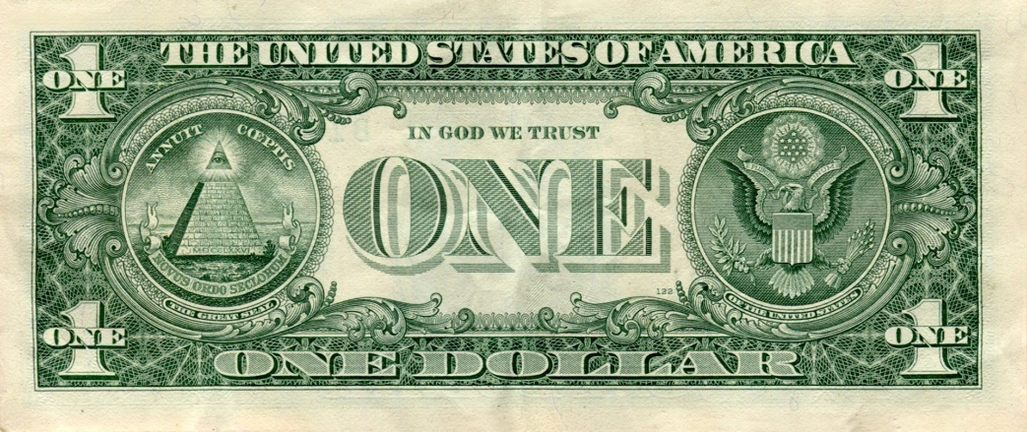
THE DOLLAR DRIVERS AND JANET YELLEN EFFECT

Slide 3
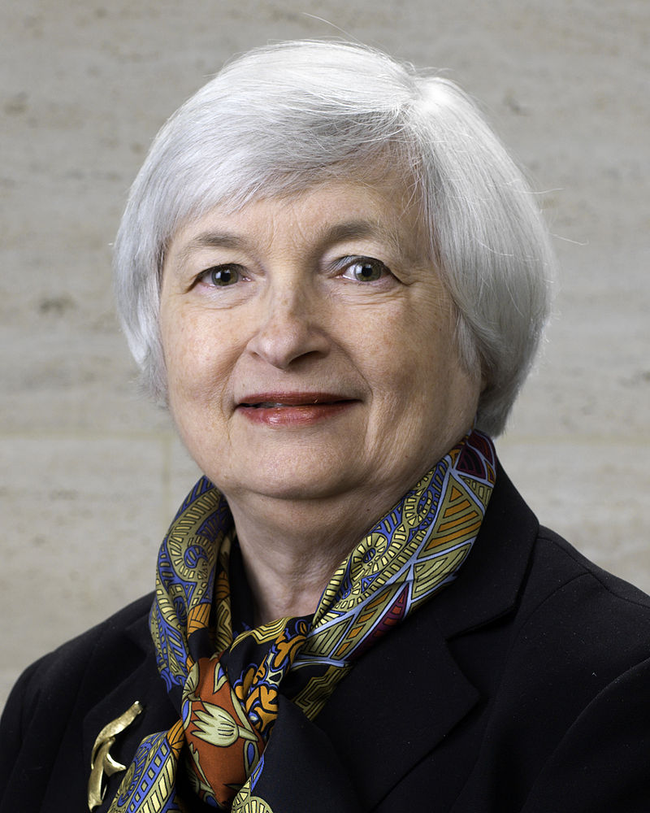
JANET YELLEN’S EFFECT
The Federal Reserve has every intention to raise interest rates one more time this year and 3 times in 2018.
Hawkish monetary policy on 20th of September outlook caught many investors by surprise and sent the dollar soaring against all of major currencies.

Slide 4
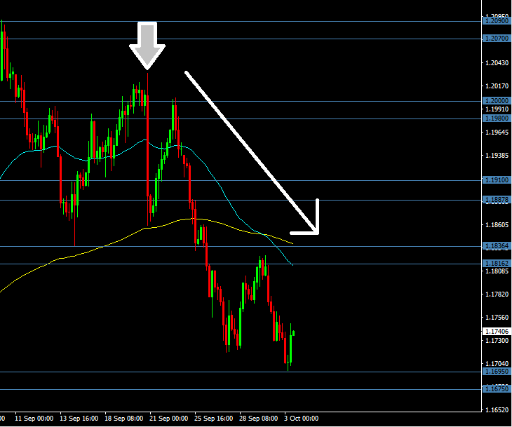
EURUSD dropped below 1.19 on the back of this announcement and continues to 03/10/2017 to drop.

Slide 5
WHAT ARE THE DRIVERS?
Geopolitical risks remain in the spotlight during these times of uncertainty.
Trump’s policy about tax cuts.
It depends on whether interests are really raised or not in December.
Good economic indicators for the US (NFP, PMI, GDP).

Slide 6

BRENT OIL AT ITS HIGHEST

Slide 7
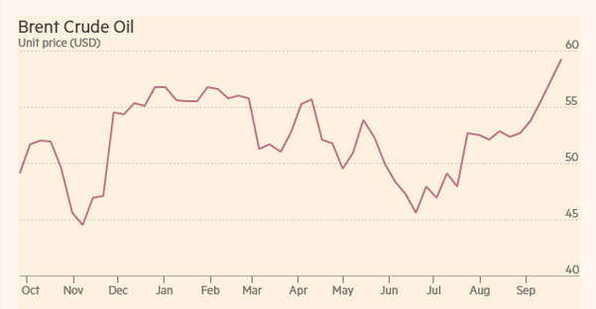
BRENT OIL
At its highest
2) Why?
Fast growing demand.
Iraqi Kurdistan referendum and Turkey’s pressure on Kurdistan.
Irma & Harvey.
3) Massive crude hedging

Slide 8

Saudi Arabia’s New Reforms

Slide 9

Women driving in KSA after 83 years
Prince Mohammed bin Salman is behind it all
24 June 2018
Time to end the repression of women
Only if in accordance with Sharia law
Decision linked to the damaged International reputation
Hope for a public relation benefits and increase women’s participation in the workplace
Reduce the government’s high expenses on employments (drivers)
Why now?
Discussed since 2014
For Economical and political matters
➔ Many Major Improvements

Slide 10


RUSSIAN MOROCCAN ENERGY COOPERATION

Slide 11
The sectors
Liquefied natural gas (LNG)
Liquefied petroleum gas (LPG)
Electricity
Renewable energies
Hydrocarbon Exploration
Nuclear power

Slide 12
Electricity
Establishment of power stations
Maintenance
Upgrading
Renovation
Installation of power lines

Slide 13
Building nuclear facility
Share the Russian expertise
Transfer of necessary equipment
Training of scientists and technicians
Use of radioactive product in the agriculture

