Slide 1
Country Risk
Group 2 – Ahsen, Roopa, Julien & Karthik

Slide 2

PUERTO RICO
Hurricane Maria consequences

Slide 3
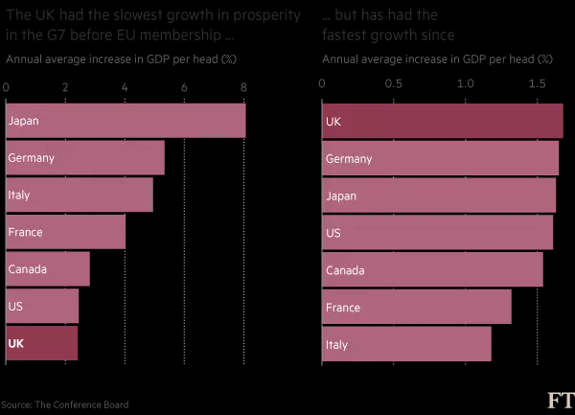
Britain sinks to bottom of G7 growth table
The neighbor leaving the EU
Short term and Long term Effects
Membership has not hurt the UK but uncertainty remains

Slide 4


Deepening capital markets in Philippines
Background – Across Philippines and the other Asia’s emerging markets, about $800 billion in investment opportunities goes unfilled.
Disadvantages
Higher costs of capital in Philippines i.e. 14%for equity and 2-3% for debt.
Low liquidity
High trading costs
Problematic hedging mechanisms
Action
Spending 7% of GDP on Infrastructure.
Policies for deeper capital markets.
Policies
Expanding the investor base would help to expand the supply of capital.
Increasing the participation of issuers in the capital markets
Charting a path toward sustainable integration with global markets
Developing a deep, liquid government bond market

