Slide 1
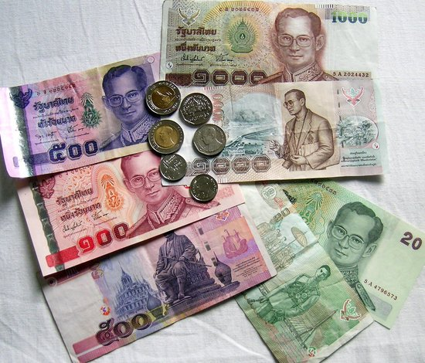
Thai baht
History, exchange rates

Slide 2
History
➔ Originally, a unit of mass, then used as money
15g of silver : 1 Baht
➔ Now
Now, 1 Baht weights 15g
Symbol : ฿
Issued by the Bank of Thailand
Tenth most frequently used world payment currency

Slide 3
Exchange rate history

