Slide 1
LOMBArdy and veneto: the next catalonia? & SAUDI ARABIA’s anti-corruption crackdown
Shadie Paris and Lucas Pilotti

Slide 2
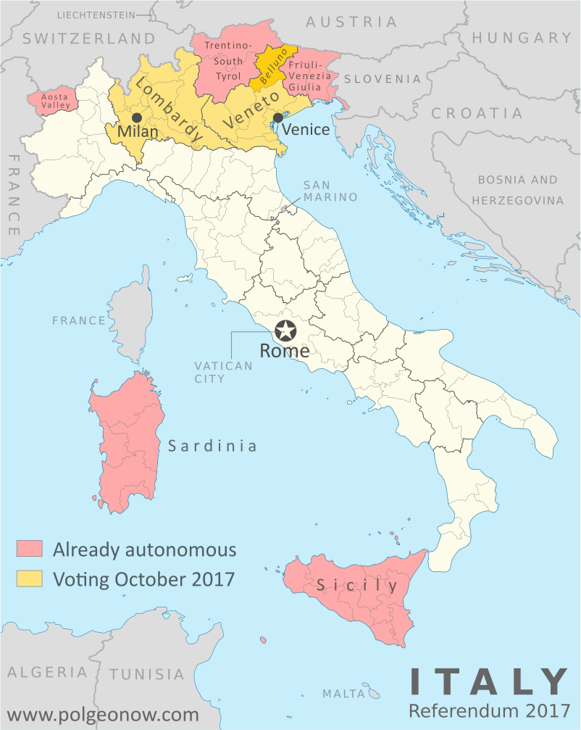
What lead to the public vote?
Lombardy and Veneto: referendum on local autonomy held on October 22nd.
Context ➔ Italy is split between the North and the South + cultural and economic gaps
Northeners’ complains: taxes, migration policy, spending.
Leaders in Lombardy and Veneto: Roberto Maroni and Luca Zaia from the Northern League party.

Slide 3
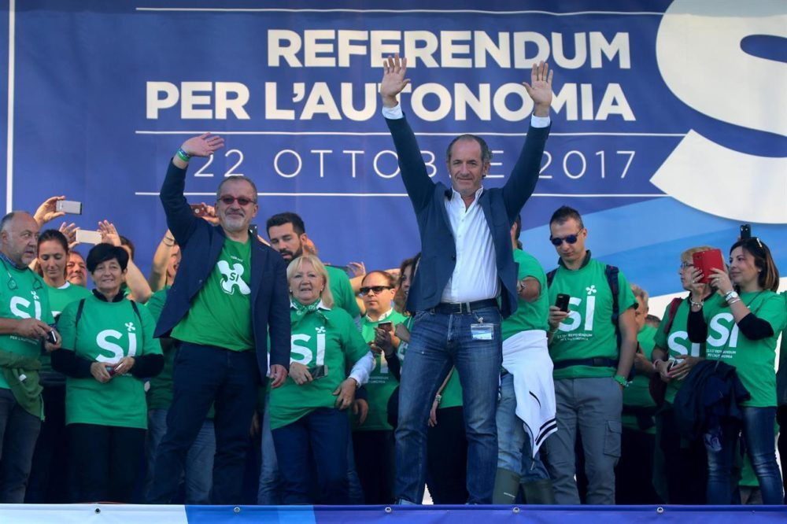
What was the outcome of the ballots?
Huge victory in terms of « yes » votes: 95% of
voters opted for more power.
Focus on turnout:
37% in Lombardy.
57% in Veneto.
Northern League party strenghtened on the
back of the results.

Slide 4
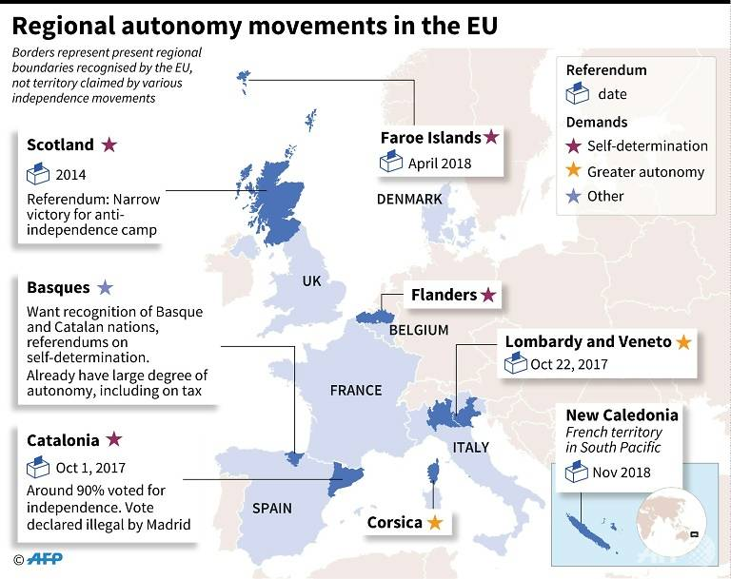
The Italian referendum: a game-changer?
Disruptive forces in Europe: Catalonia, Brexit, Scotland ➔ now Italy?
Northern League’s objective has shifted ➔ from secession (« Padania ») to autonomy.
Regional referendums were legally approved by Italy’s constitutional court.
As Zaia said, “The referendum of Veneto does not question a break in either the supranational right nor with respect to international law, nor with respect to the Italian constitution."

Slide 5
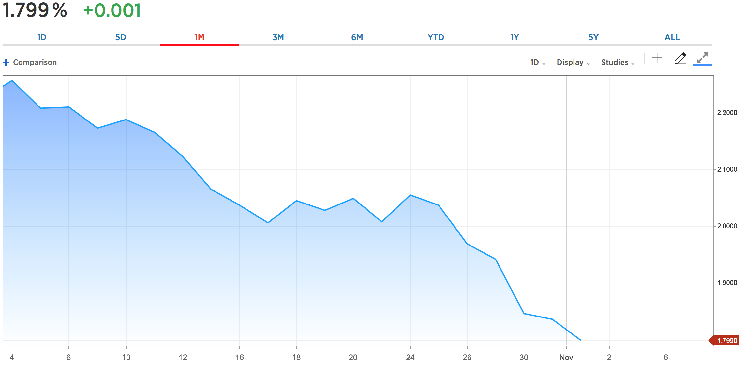
Reaction on Italy’s 10-Year Yield
Release of the results

Slide 6
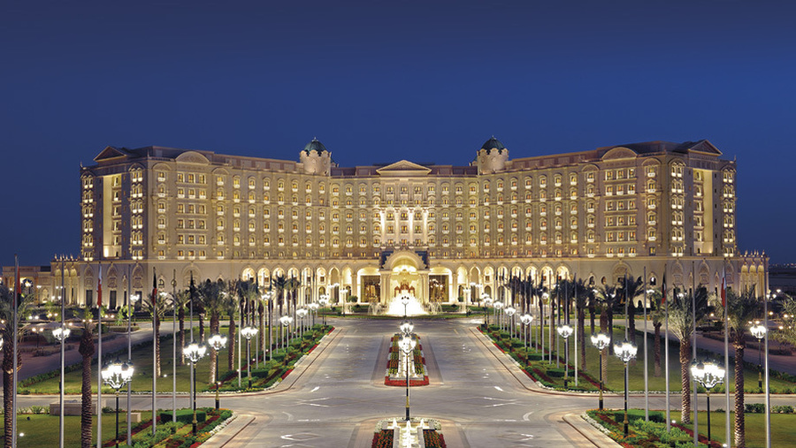

Slide 7
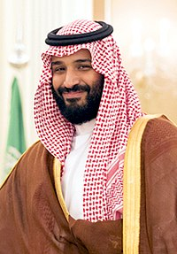
What lead to the crackdown?
Saudi Arabia in the midst of big economic disruption
Oil price in 2014 fell to historically low level : $25/bbl price
Failing to attract Foreign Direct Investments (FDI)
The world bank « Doing business » ranking: 22nd in 2013 ➔ 92nd in 2017
Why?
Lack of transparency and unfair treatment to its investors
How to cope?
Bring Saudi Arabia into globalization with its vision 2030 strategy plan
Investment park initiative Neom ($500bn)
➔ Deliver revolutionary change, moderating religious strictures and weening off dependence on oil

Slide 8
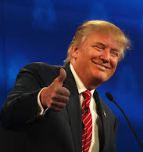
What happened?
Royal decree of an anti-corruption commission :
11 princes, 4 ministers and dozens of former ministers and businessmen taken into custody
➔ Add credibility for investors
The move drew support from President Donald Trump
Real anti-corruption war or removing possible challengers to cement his own power??
Outside the borders:
Lebanese Prime Minister unexpectedly resigned and is said to be detained by Saudi forces
Yemen fired a missile toward Riyadh and it is still not clear who financed the missile launch MBS accused Iran of “direct military aggression” by supplying missiles to Houthi rebels in Yemen

Slide 9
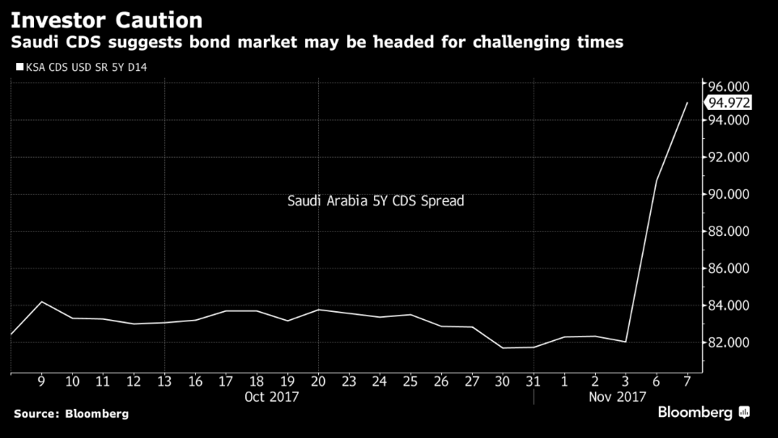
Reaction on the market

Slide 10
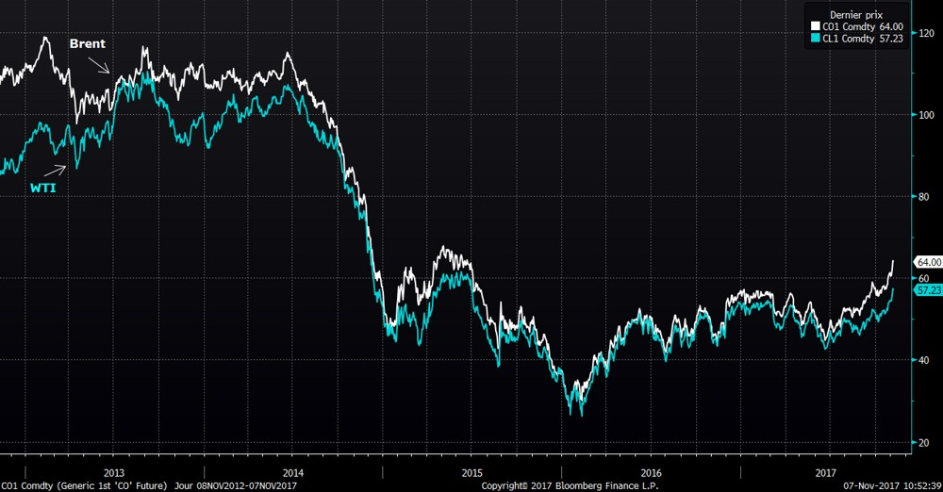
Reaction on the market
On Monday:
Brent + 3.54% to $64,27
WTI +3.07% to $57.35

Slide 11
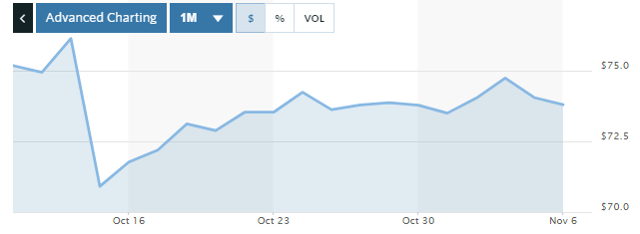
Reaction on the market
Citigroup Inc. down 2.24% as one of the major shareholders under arrest

